Slide 1


Slide 2
PROJECT METHODOLOGY – DESIGN THINKING APPROACH
Research Design
Primary Research
Data Analysis
Insights and Recommendations
Milestone
Milestone
Milestone
Type of Study: Exploratory
Research Geographic Area: Kolkata
Source of Data: Primary and Secondary Research
Research Approach: Survey Method – Interviews, Questionaries
Mode of Data Collection: Structured questionnaire for surveys and interviews – separate for gamers, software and print subscription
Sample Size: At least 50 responses from people of the age group 16 – 50
Persona Identification & Storyboarding: Across gaming, software and print subscription services
Empathy Map Creation
Pain Points Identification
Needs Identification
Generating targeted insights and proposals to cater to the aspirations and deal with the challenges faced by consumers
Listing down recommendations – Prioritization Matrix
Notes:
<a href="https://www.freepik.com/free-photos-vectors/background">Background photo created by halayalex - www.freepik.com</a>

Slide 3


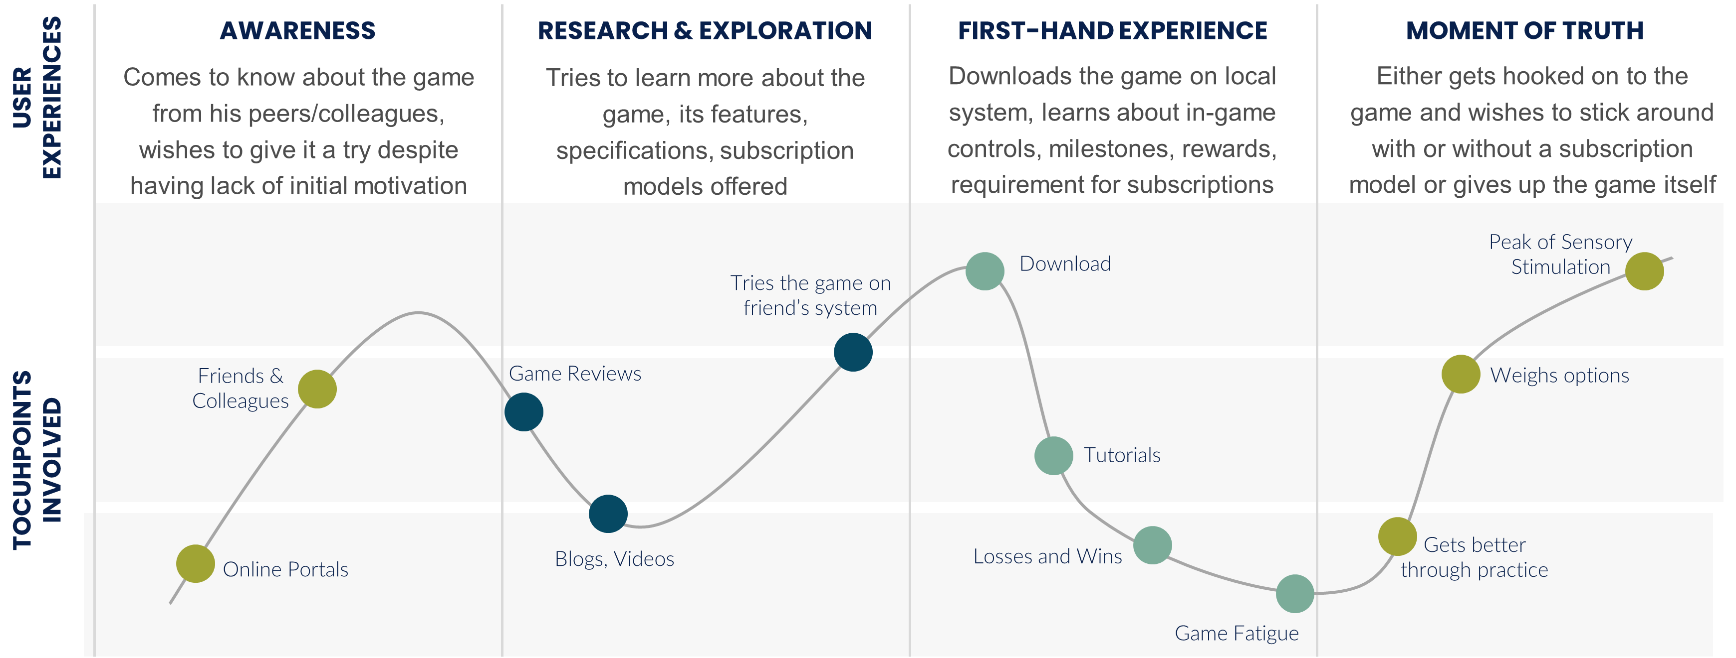
USER PERSONA AND CUSTOMER JOURNEY
Bio
Bunty Sharma, 27
“NEWBIES”
There are players with no experience with games and gaming environments. They hopped on the bandwagon because of the hype and social/peer pressure. Keeping them engaged and meeting their aspirations for a sustained period of time is the key for them to convert to subscription models
A working professional and an aspiring entrepreneur
Has done B.Tech. in IT, has been working since the last four years
Has been always attracted to gaming but never really got the motivation to dig in deep, devote time and explore gaming options and subscriptions
Has people in his friend circle who are gaming subscribers – popular ones being Action Games – Call of Duty, Battlegrounds Mobile India, EA Sports FIFA
Possesses inhibitions around subscription models pricing, value add
Pain Points
Lack of informed opinion around gaming and subscription models
Inhibitions around saliency of subscription models
Lack of time to devote to time-consuming games
Price constraints with respect to subscription models`
Notes:
<a href="https://www.freepik.com/free-photos-vectors/background">Background photo created by halayalex - www.freepik.com</a>

Slide 4
INSIGHTS ON SUBCRIPTION MODELS ACROSS DIFFERENT SEGMENTS
DIGITAL MEDIA
PRINT MEDIA
Subscription models in this segment offer customers choice of site-wide access to premium content or content-specific access. This leads to price segregation basis the user’s requirements. Bundling of content through subscriptions also takes places; e.g. Mint + Wall Street Journal
Monthly, quarterly, semi annual, annual subscriptions offering access to home-delivered print content. Such models offer lowered unit prices for subscribers, bundle offers – e.g. bundling magazines with newspapers, bundling premium digital content with print content etc. There is a need for coming up with innovative subscriptions models in this segment due to the exponential growth of digital media consumption
SOFTWARE SUBCRIPTIONS
A wide range of subscriptions models are available to businesses across the entire spectrum of personal and professional softwares. Models range from flat-rate pricing, tiered pricing, usage-based, add-ons. The proliferation of pirated versions dents the subscription models for personal softwares however hosting the product on cloud can eliminate the usage of cracked or hacked versions
STREAMING AND GAMING
Segments seeing huge prevalence of subscription models – Freemium, pay per usage. Models in these segments offer access to premium content for as less as a day. Exclusive season-based passes are also a popular subscription feature in gaming services; e.g. Xbox Game Pass, Call of Duty Battle Pass

